Slide 1
DEPARTMENT OF CSE
COURSE NAME
COULD and devops
COURSE CODE
20CS3019AA
Topic
Kubernetes Architecture

Slide 2
AIM OF THE SESSION
To familiarize students with the basic concept agile modeling
INSTRUCTIONAL OBJECTIVES
This Session is designed to:
Demonstrate Kubernetes Architecture
Describe Kubernetes on Windows
LEARNING OUTCOMES
At the end of this session, you should be able to
Define Kubernetes Architecture
Describe Kubernetes on Windows
2

Slide 3

AGENDA
Kubernetes Architecture
Kubernetes on Windows

Slide 4
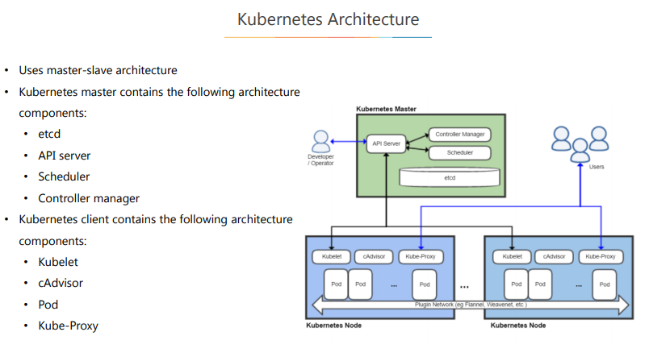
SESSION DESCRIPTION

Slide 5
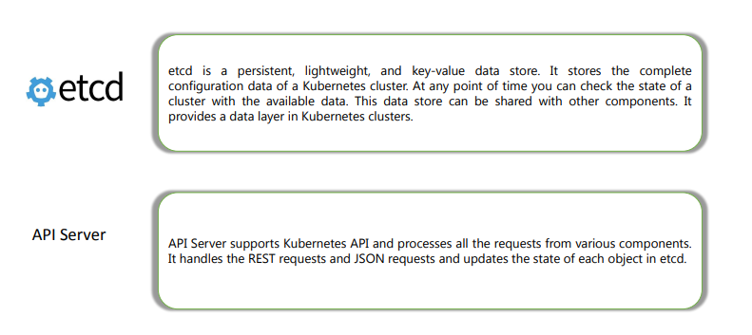
Kubernetes Master Components

Slide 6
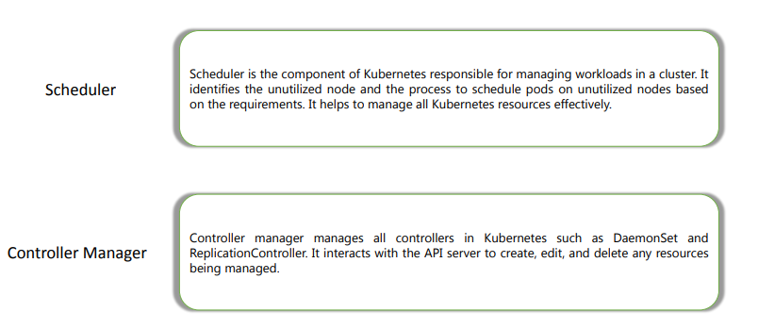
Kubernetes Master Components

Slide 7
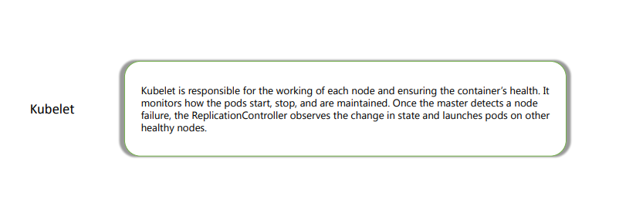
Kubelet

Slide 8
SELF-ASSESSMENT QUESTIONS
Describe about Kubernetes Architecture ?
Describe about Kubernetes on Windows ?

